Slide 1
Minor Project Presentation

Slide 2
Team Members
Narayan Punase
Nitin Negi
Piyush Soni
CSIT 2
3rd Year

Slide 3
Topic
Farm Equipment Rental System

Slide 4
Abstract
Here, we developed E-commerce website to bridge gap between vender and farmer. We are trying to provide service like take required equipment from vender on rent basis. As information concerning farm related equipment are not affordable to all farmer. The main objective of this website is to manage a fleet of agricultural machinery including various farming equipment such as harvester, JCB, Tractor, Pickup, rotor and so on. This proposed system is user friendly for end user. The objective of website is to deliver the online farm related equipment through web platform. It helps buying the equipment in the shop anywhere through internet through Mobile and Computer. Users can enjoy the shopping from anywhere.

Slide 5
Introduction
In today’s world, every farmer does not have sufficient money to buy every equipment which is required for farming. So, here we are trying to provide service to farmer or user that they can take equipment on rent per hour basis. Comprehensive services that deliver equipment’s when and where needed, with minimum waste of resources. If any new farmer wants to do farming, he doesn’t know about the farming equipment as per this concern this website is implemented. Our website has a facility to give a unique id for each and every farmer and also for vender and also registered equipment also. The system can access by any person no special training is needed to handle this. System can also provide online payment facility for pay rent of that specific equipment by using online payment applications such as Paytm, Google Pay.

Slide 6
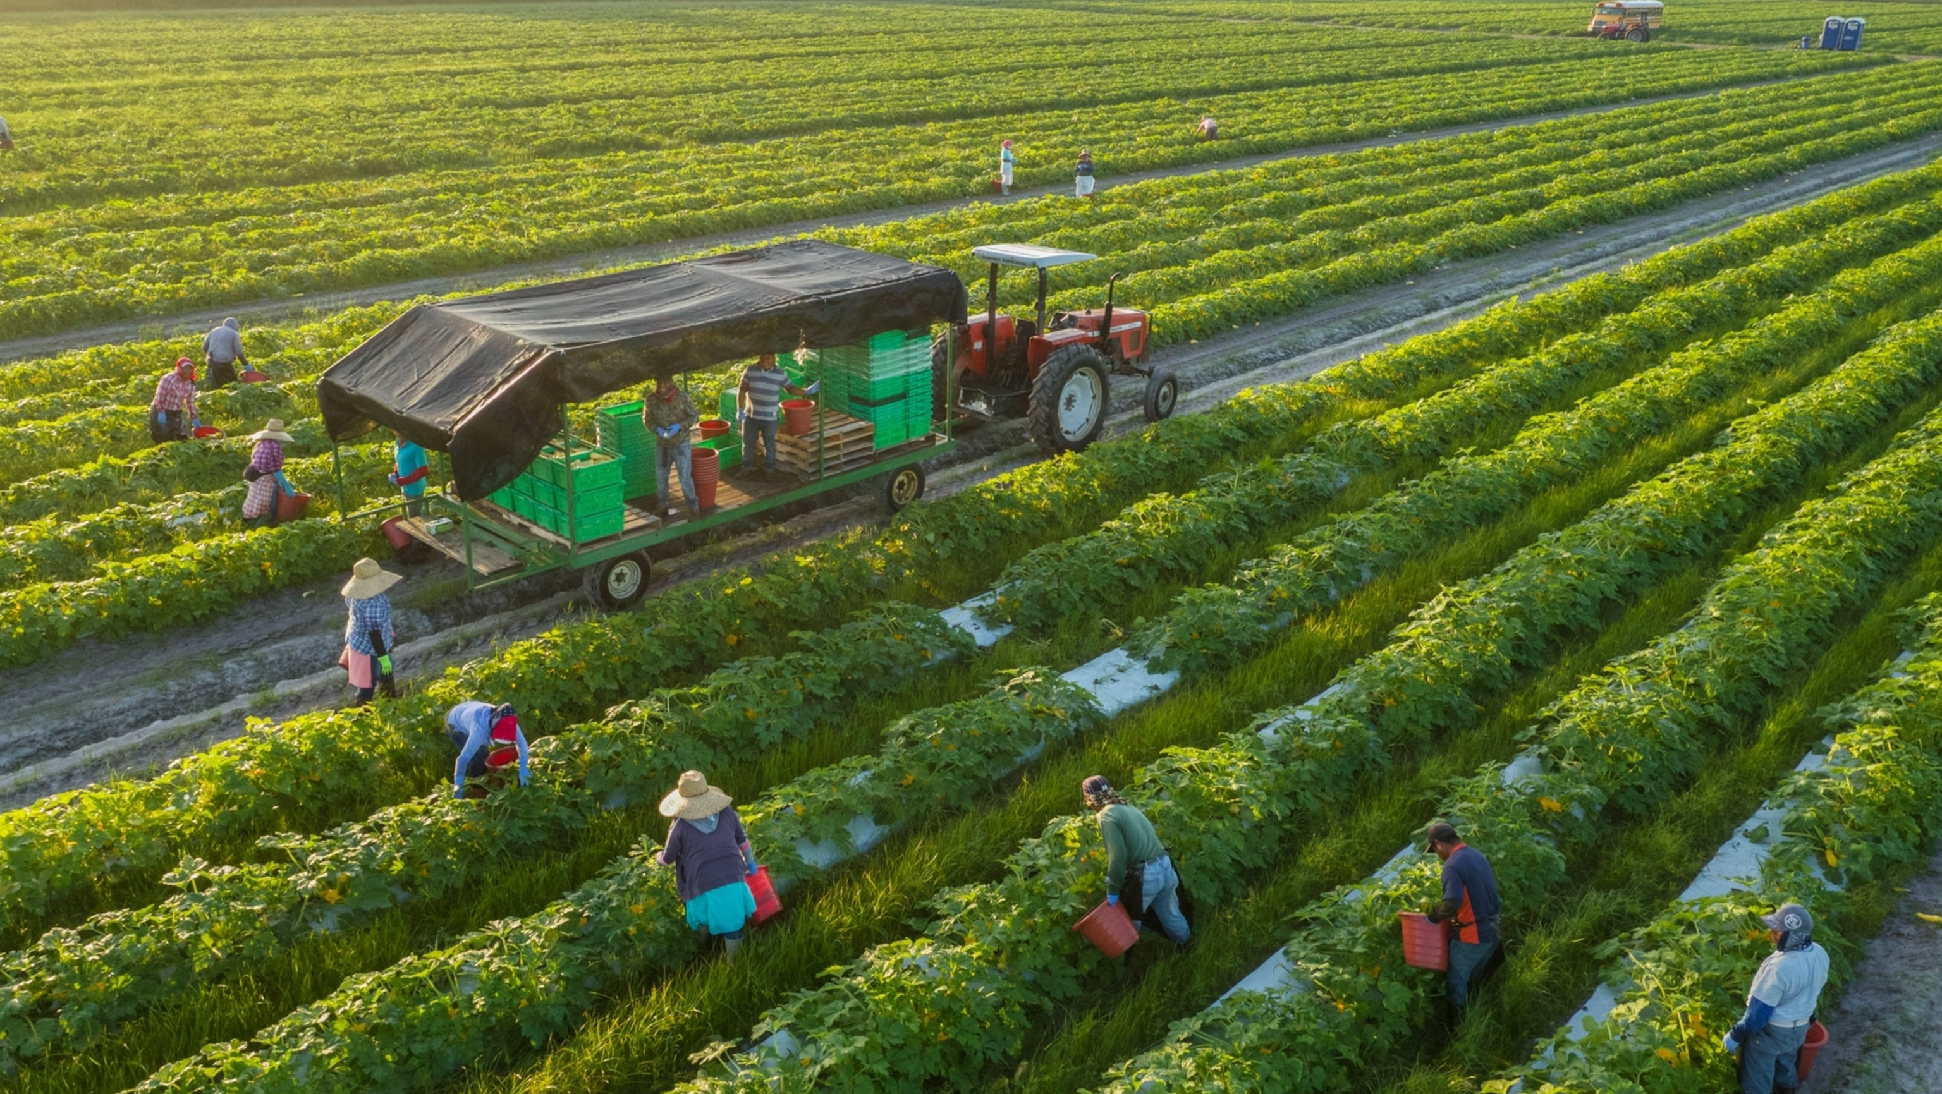

Slide 7
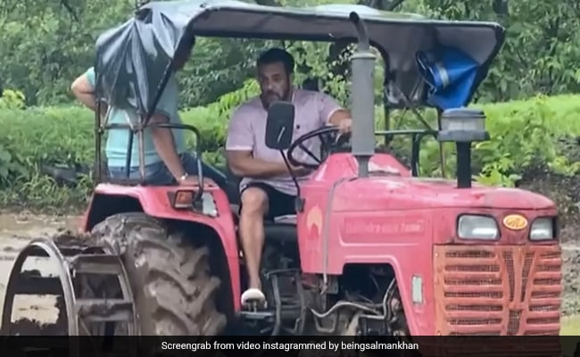

Slide 8
Problem Statement
Every farmer does not have sufficient money to buy every equipment which will require for the farming. So, here we are trying to provide service to the farmer or user that farmers can buy equipment’s on per hour rent basis. Comprehensive services that deliver equipment’s, when and where needed, with minimum waste of resources. Our software has the facility to give a unique id for every product and users. The details of every product and the user will store on database automatically.

Slide 9
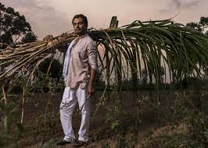
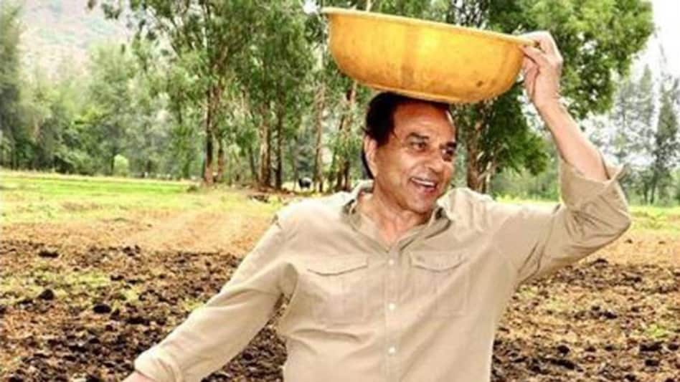
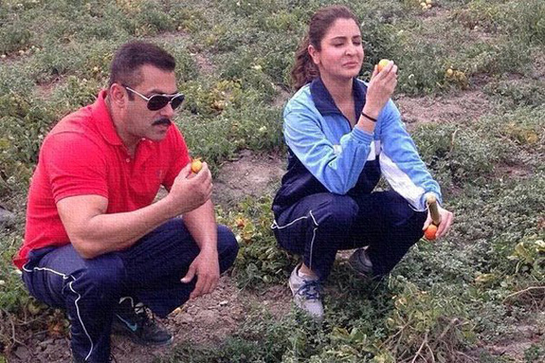
We want to see smile like this on our farmers face

Slide 10
Proposed Solution
The Farm Equipment Rental System website is user-friendly website. The main objectives of the system which shows and helps you to farmer for buying equipment’s on rent basis, rent can be on day basis. So, farmer or vender does not need to buy every equipment which they required. The design and implement of the system is simple. The system needs very low system resources and the system will work in almost all configurations.

Slide 11
Technology Stack
The entire development process has been subdivided into two: the front-end development and the backend development. The front end comprises of the visually visible parts such as the home page, admin panel, contact page, About us page, vender and farmer panel. The back end contains the database and its interaction with the front-end.

Slide 12
Front End Development
The front end was initially raw coded using HTML and CSS. Hypertext mark-up language is the language used to design the web pages of an application. A static page is an HTML document that is stored on the web server and does not change. This was performed by Cascading Style Sheet (CSS). CSS is a style sheet language which describes the look and formatting a document. These CSS files are linked with the class files with .php extensions to put the panels in order, the text with correct font,size and color.

Slide 13
Back End Development
The Database Management System provides support for the back end. The database management system is essentially software where admin can create the database, add, drop, alter and update tables. The tables can hold different types of data for example: integer, variable characters etc. in our application we have chosen the MySQL DBMS to hold the database. MySQL is a relational database management system. The main reason is MySQL development project has made its source code available under the terms of the General Public License (GNU) which is an open-source web application.

Slide 14
Applications of Proposed System
Security of data
Ensure data accuracy
Reduces the damages of the labour
Greater efficiency
User friendly and interactive
Minimum time required

Slide 15
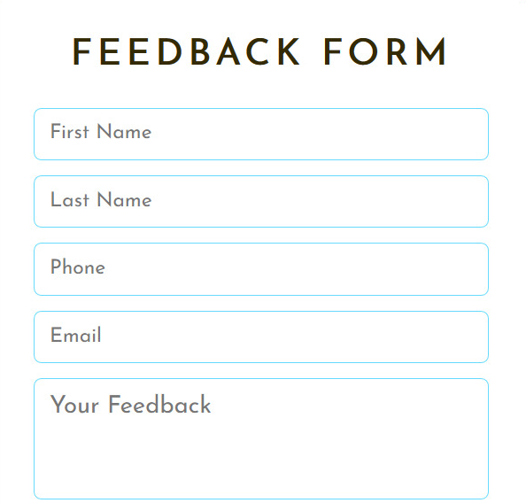
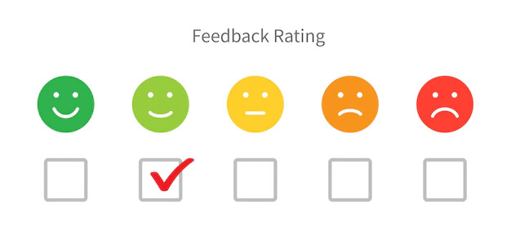
Feedback

Slide 16
Conclusion
World Wide Web has become a major resource in modern business it gives new opportunities to business. The website is attractive, provides easy navigation, multiple options in terms of brands,
category and capacity the farmer would stay on the site. This paper provides an easier design to implement the website and this system not only provides easy navigation but also it can increase the
profitability and reduce time, efforts of farmer and make sure that all important information are able to use in future use.

Slide 17
Hence the proposed system has following features.
Multiple add to carts can be provided per user.
A desktop-based application for the website can be developed.
Payment through Paytm could be made possible.
Send SMS to the users on registered mobile number.

Slide 18

Before using our service

Slide 19
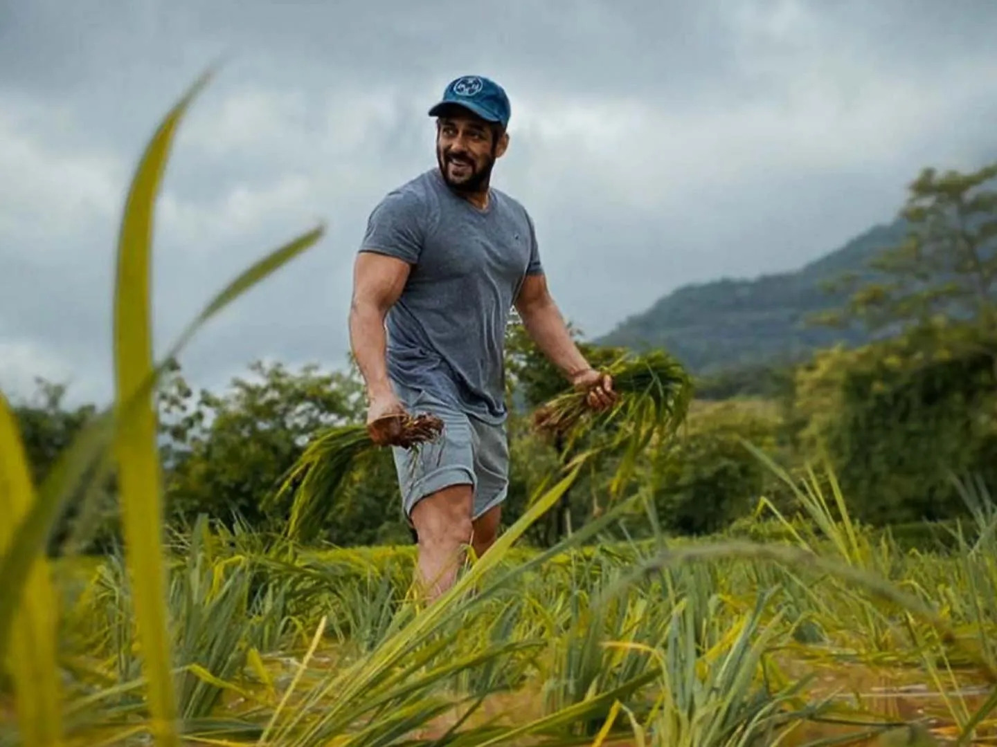
After using our service

Slide 20


